Slide 1
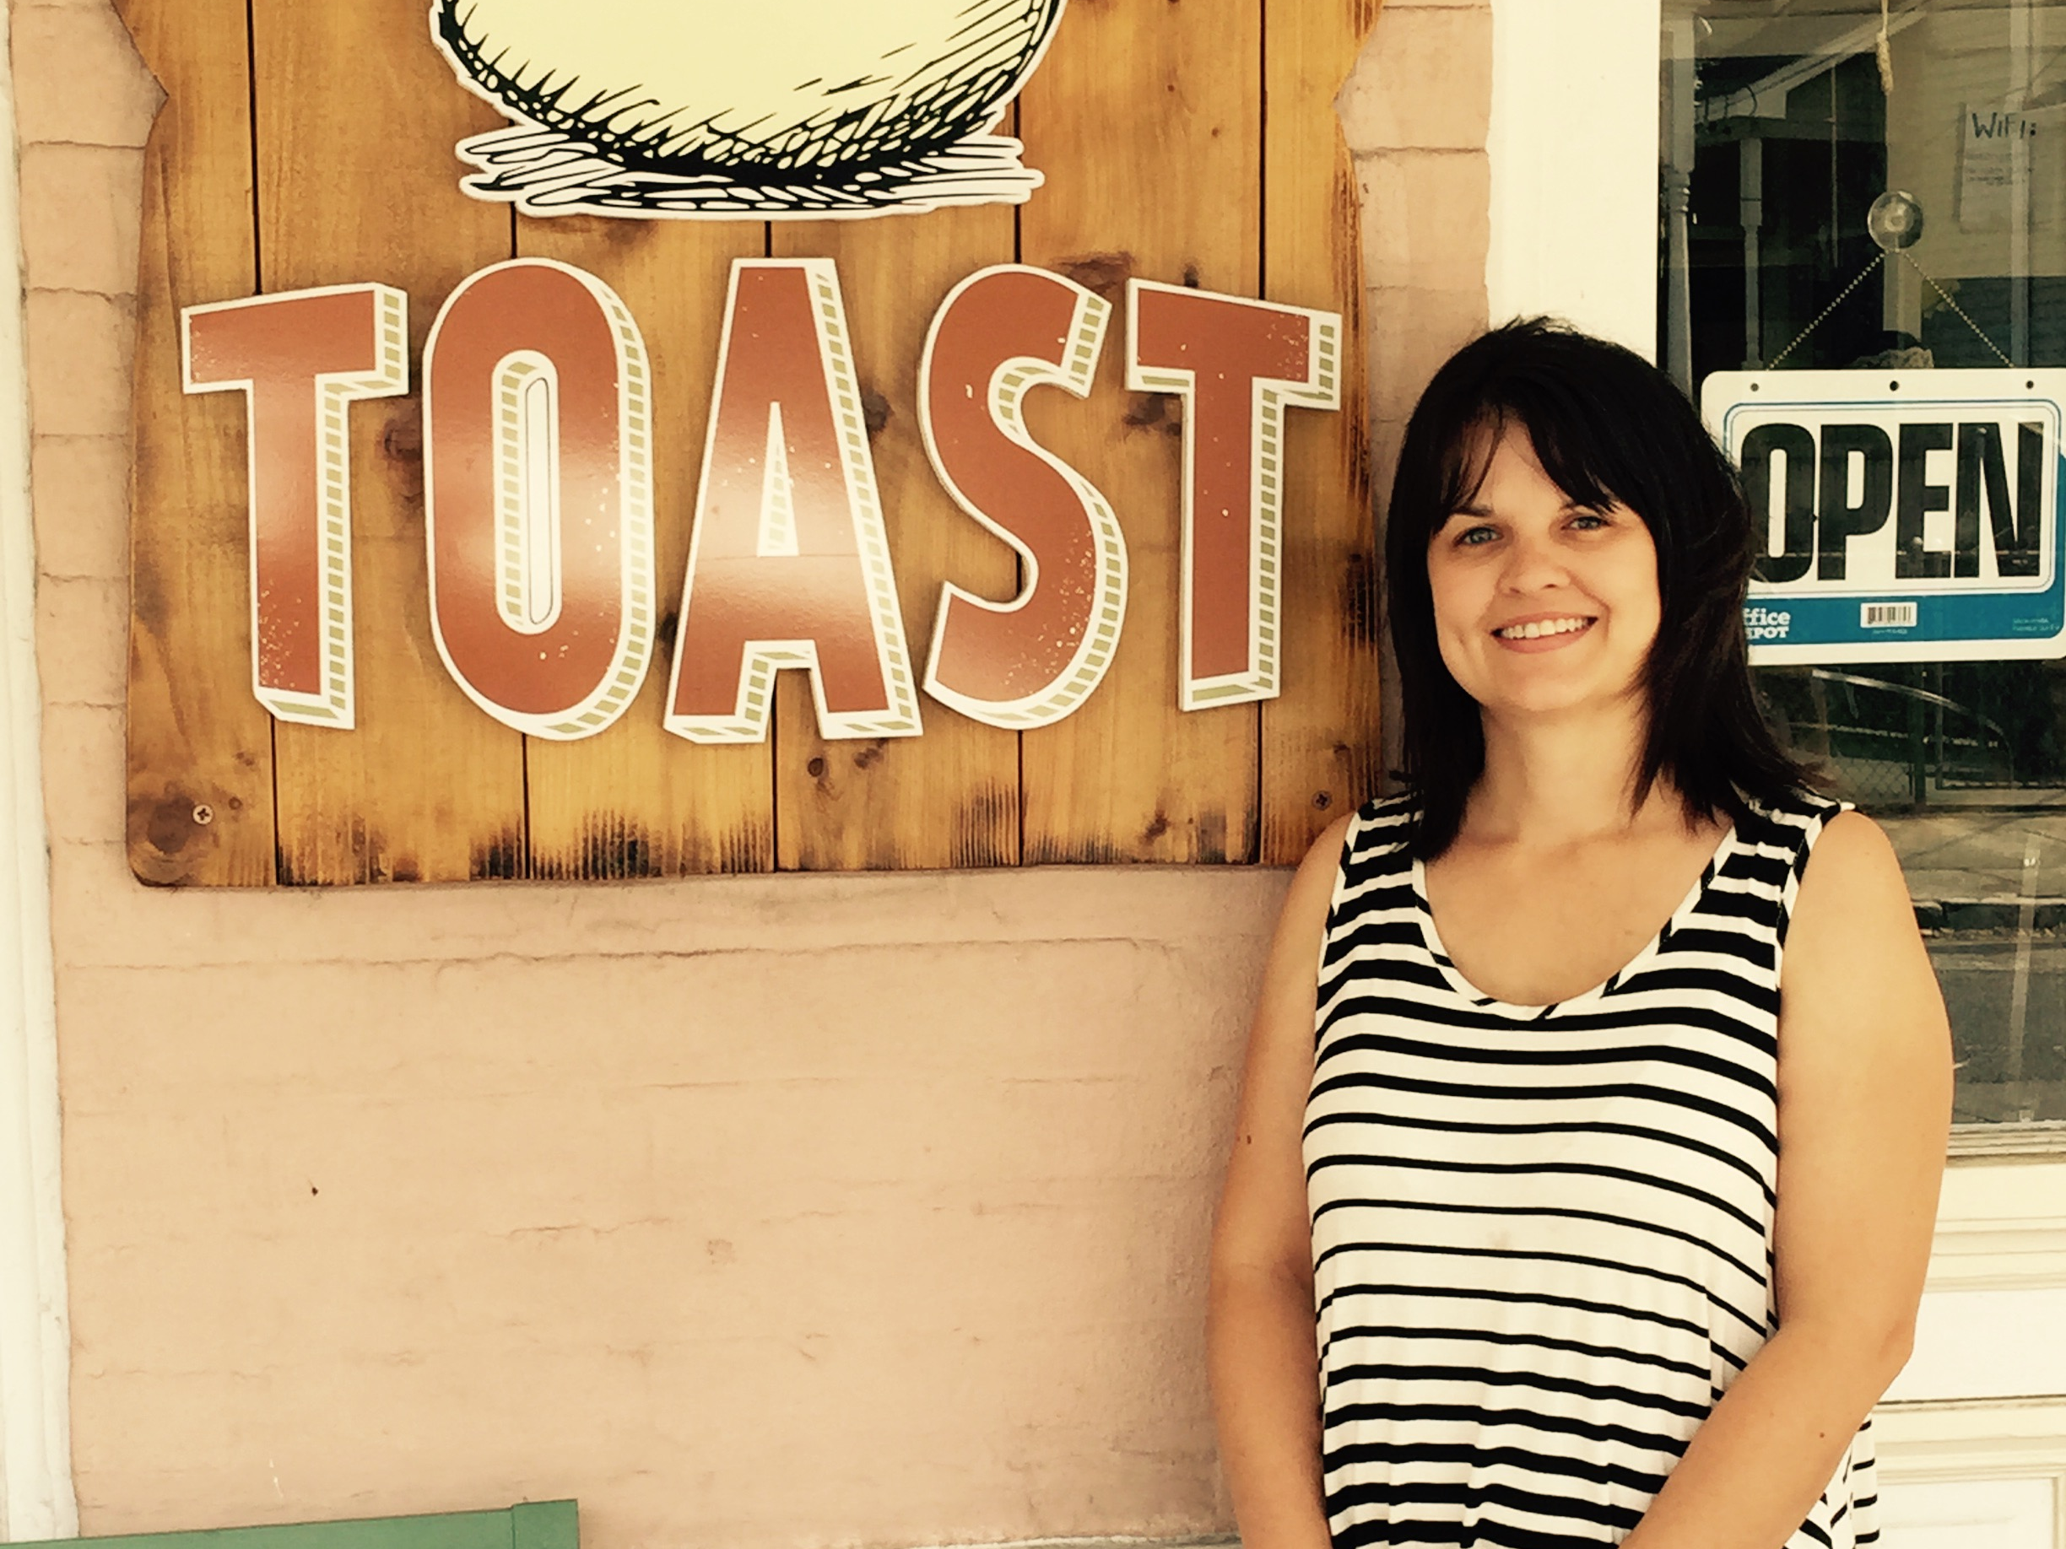
I really love DAVO! It has taken so much stress off of me not worrying about taxes all of the time. It really is the best thing ever! Thank you for taking that dreaded task over for me, it is very much appreciated!!
Please let me know if you would like me to be your spokesperson ☺.
–Cara Benson, Toast and Tartine restaurants
Notes:
And another….

Slide 2
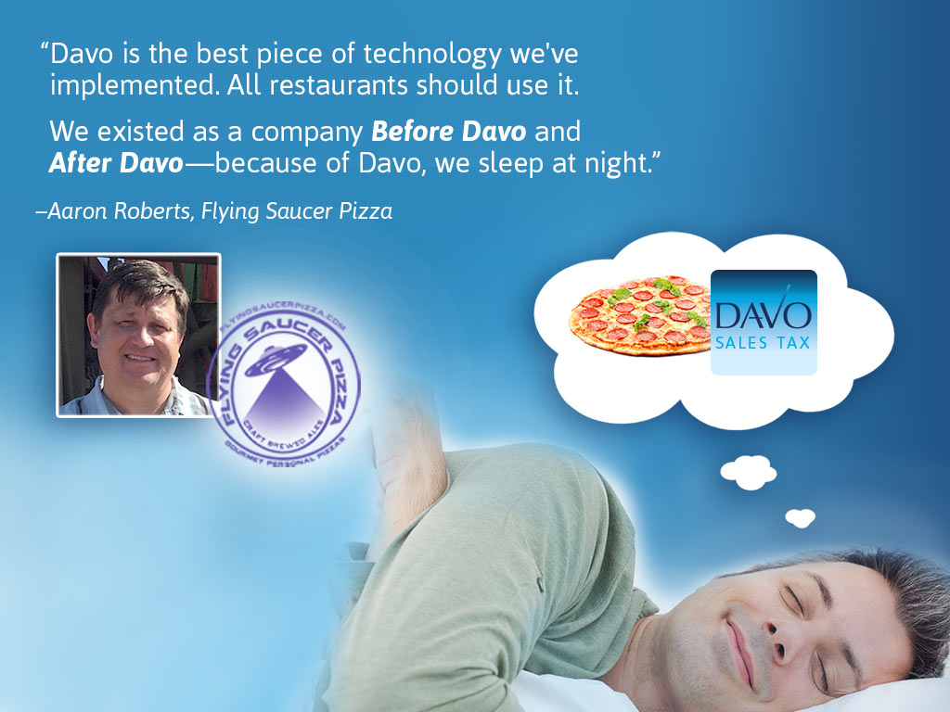
Notes:
And another….

